Slide 1
LAODICEAN PERIOD
REVELATION
3:14-22

Slide 2
LAODICEA MEANS RULE BY THE PEOPLE
THE CHURCH TODAY IS RUN BY THE BALLOT BOX
THE PASTOR IS NO LONGER THE HEAD OF MANY CHURCHES TODAY
POPULAR OPINION HAS NEVER BEEN THE WILL OF GOD

Slide 3
IN 1948 THE PASTOR OF THE PARK ST. CHURCH IN BOSTON COINED THE PHRASE: “NEW EVANGELICALS”
NEW EVANGELICALS BELIEVE THERE ARE ERRORS IN THE BIBLE

Slide 4
BILLY GRAHAM BECAME THE SPOKESMAN FOR THIS NEW WAVE OF LIBERALISM
1. DEMANDED LIBERALS SPONSER CRUSADES ALONGSIDE FUNAMENTALISTS

Slide 5
2. IN 1957 ANNOUNCED HIS INCLUSIVE POLICY (TO INFILTRATE RATHER THAN TO SEPARATE)
3. CLOSE ASSOCIATION WITH CATHOLICS
4. A HIGH RANKING MASON
5. WORLDLY MUSIC

Slide 6
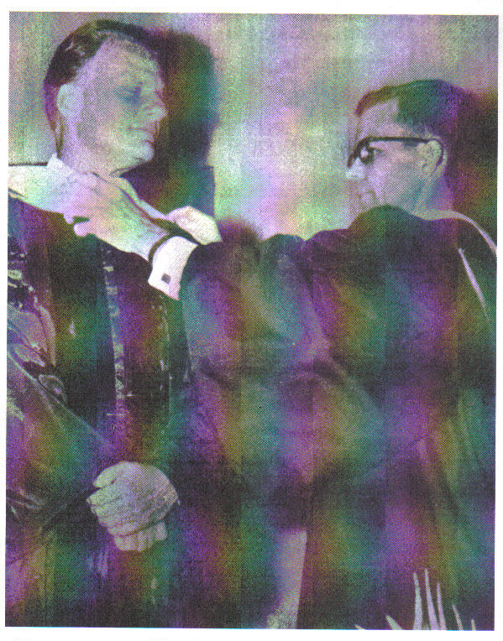
1967 – Billy Graham receiving yoke of Rome from Jesuits at Belmont Abbey College

Slide 7
LARGE RALLYS TO DRAW LARGE CROWDS
EXPLO 72 – ROCK MUSIC
KEY 73 – MASSIVE PROGRAM TO REACH N. AMERICA (CATHOLICS INVOLVED) THE MESSAGE WAS DO YOUR OWN THING

Slide 8
ECCUMENICAL MOVEMENT
JOINING TOGETHER OF DENOMINATIONS
CASTING AWAY OF DOCTRINAL DIFFERENCES
WORLD COUNSEL OF CHURCHES

Slide 9
Charismatic influence
Came out of the catholic church
Catholic priests involved in ecumenical services
Lowering of the standard
True Pentecost is not charismatic

Slide 10
Jesuit infiltration
According to Alberto Riviera an ex – Jesuit priest , Kathryn Kuhlman was a Jesuit plant
Worldly in appearance
Catholics on the platform
Esoteric (way out) in presentation

Slide 11
Planned attacks on the Pentecostal movement
Deliberate promotion of compromise
Modern charismatic leaders have involvement with catholics
Priests speaking in tongues

Slide 12
FALSE PROPHETS
Benny Hinn is a false prophet
Joyce Myers is not of God. That is another spirit
The TBN crowd is a mess
Many are being deceived – Matthew 24:24

Slide 13
MODERN PERVERSIONS OF SCRIPTURE
From corrupted manuscripts
Yield confusion
Attack the Deity of Christ
Promote compromise
NIV accepted by the Catholics

Slide 14
THE CHURCH IS ASLEEP
LUKEWARM
COMPROMISING
CHARASMATIC MOVEMENT
A FALLING AWAY
DECLINE OF ORGANIZED PENTECOSTAL CHURCH

